Slide 1
5 Why Analysis
Topic: Compliance Policy
Group 2

Slide 2
Issue Description
[Fact]
Sometime, some employee do not comply policies in company
[Expectation]
All employee must remember and comply policies when working at company.
[When does it happen]
New employee join company.
New policy is promulgation or modification.

Slide 3

Some Error
Take photo and record in RVC
At the RVC, photographing and record are forbidden. Because you can disclose business secrets and the technology of the company.
Source: www.bing.com

Slide 4

Some Error
Working late
You have to go to company before 8 AM and leave the company after 5 PM, before 10AM, out after 3PM for flexible
Source: www.bing.com

Slide 5
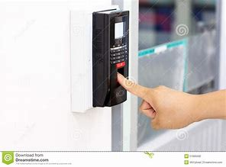
Some Error
Forget Scanning In & Out
You have to scan fingerprints of arriving and leaving the company. Data of fingerprint scanning will be shown on Silk Portal to timekeeping and salary for you. .
Source: www.bing.com

Slide 6

Some Error
Give document, information, material of company out
Workers not be unconsciously or deliberately, disclose to any person, including the ones in the family, or those of other Workers in the company (except the President or the person authorized by the President) , any confidential information whatsoever under any form whatsoever, which Workers was known in the process of working or otherwise.
Source: www.bing.com

Slide 7
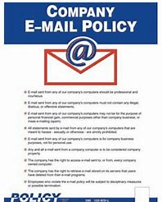
Some Error
Use the company’s mail with personal purpose
Workers have to be careful when using the company's mail. Not receiving or reading mail from strangers to avoid infection of virus. Notice, not to use the company's mail to send mail to anyone outside the company without allowing.
Source: www.bing.com

Slide 8
Direct Cause Analysis
[Q]Why employee do not comply?
[A] - By attitude is not good.
- By do not understand clearly company 's rule.
- By be not informed clearly by employer.

Slide 9
Direct Cause Analysis
[Q1] Why attitude is not good?
[A1] - By do not practice and train.
- By do not have goal and motivation.
[Q1.1] Why not practice?
[A1.1] - By transition from the university environment to the industry environment (root).
- By no goal and motivation.
[Q1.2] Why do not goal and motivation?
[A1.2] - Easily satisfied and complacent (root).
- Do not have trust in the company.
[Q1.2.2] Why do not have trust in the company?
[A1.2.2] - By conflict in benefit between employee and company (root).

Slide 10
Solution
- Organizing training courses by company
- Motivating and listening to the employee ‘s expectation.
- Employees need to improve by themselves.
- Update company’s procedures and rules.

Slide 11
Direct Cause Analysis
[Q2] Why are not informed clearly by employer?
[A2] Because of objective reasons.
Solution?

Slide 12
Direct Cause Analysis
[Q3] Why do not understand clearly company 's rules?
[A3] - Do not ask, read the rules carefully.
[Q3.1] Why does not ask the rules carefully?
[A3.1] - Being shy at the crowd.
[Q3.2] Why be shy at the crowd?
[A3.2] - Bad soft skills (root).

